Slide 1
Weak slot- and- Filter structures

Slide 2
Slot- and- Filter structures
Weak slot- and- Filter structures
Strong slot- and- Filter structures
Slot is an attribute value pair in its simplest form. Filter is a value that slot can take . It could be numeric, string value or a pointer to another slot.
Example -
The knowledge in slot and filter systems consist of structures as a set of entities and their attributes.
These structures have the form of ordered triples
OBJECTS x ATTRIBUTES x VALUE
The following are the four declarative mechanisms, used for representing knowledge:
Weak slot- and- Filter structures
1. Semantic Nets : These describe both objects and events in general
2. Frames: A general structure to represent complex objects from several different points of view.
Strong slot- and- Filter structures
1. Conceptual Dependencies :Provides a way of representing relationships among components of an action.
2. Scripts: A sophisticated structure use to represent common sequence of events.
India
New Delhi

Slide 3
A 'weak slot' and filler structure does not deal with the representation of the content.
The 'weak slot-and-filler' structure ('semantic networks' and frames) does not describe any hard and fast rules about what kinds of objects and links are good in general for knowledge representation.
A weak slot helps in easy retrieval of attribute values.
It helps in describing the properties of relations very easily
The strong slot-and-filler structures, on the other hand, provide specific notions of what kinds of objects and relations are permitted.
This represents links between objects according to more rigid rules. This represents knowledge about common situations.
There are two types of Weak slots and their filler structures – Semantic Nets and Frames

Slide 4
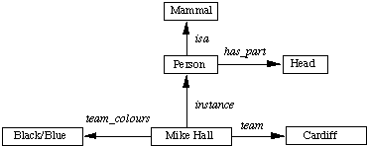
Semantic Nets
In a semantic net, information represented as a set of nodes connected to each other by a set of labeled arcs, which represents relationships among the nodes.
The physical attributes of a person can be represented a
(A Semantic Network )
These values can also be represented in logic as: isa(person, mammal), instance(Mike-Hall, person) team(Mike-Hall, Cardiff)

Slide 5
Semantic Nets….
A semantic network is a directed graphs with labeled nodes and arrows.
Nodes are commonly used for objects and the arrows for relations.
The pictorial representation of objects, their attributes and relationships between them and other entities make them better than any other representation schemes.

Slide 6
Representing Non-binary Predicates Semantic Nets
1. Simple binary predicates like isa(Person, Mammal) can represent easily by semantic nets but other non-binary predicates can also represent by using general-purpose predicates such as isa and instance.
2. Three or more predicates can also be converted to a binary form by creating one new object representing the entire predicate statement
Example
Score(India,Srilanka,160-7)
(A Semantic Network for n-Place Predicate)
Game
Visiting Team
isa
Score
Srilanka
20-20
160-7
Home Team
India

Slide 7
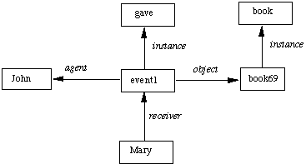
Example :
John gave Mary the book.
give(john,mary,book)
(A Semantic Network for a Sentence)

Slide 8
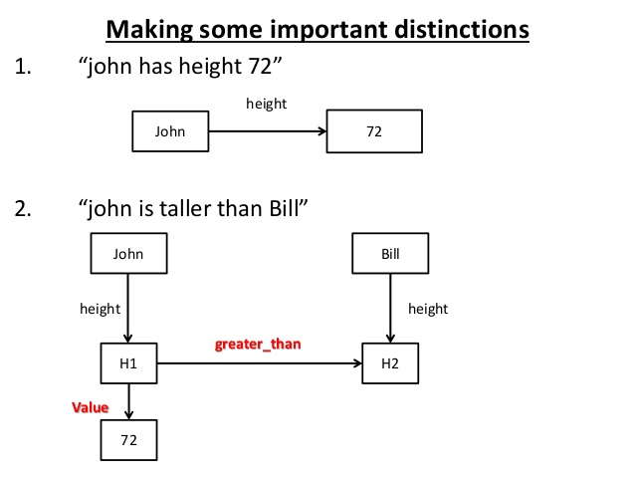
we will also need to distinguish between the link that defines a new entity and holds its value and the other kind of link that relates two existing entities

Slide 9
Partitioned Semantic Nets
It is used to represent quantified expressions in semantic nets
Notes: Break network into spaces which consist of groups of nodes and arcs and regard each space as a node.
Example - “the dog bit the mail carrier” (Partitioned not required)
dogs
bite
Mail carrier
isa
isa
isa
d
Assailant
b
Victim
m

Slide 10
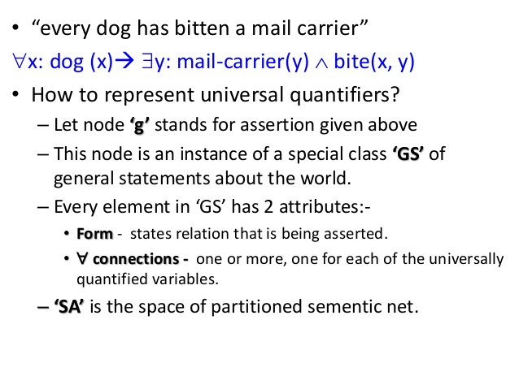

Slide 11
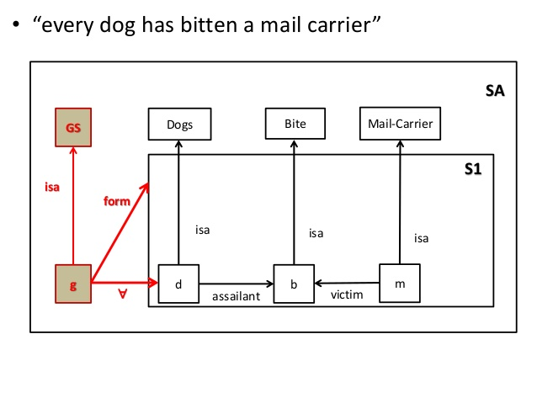

Slide 12
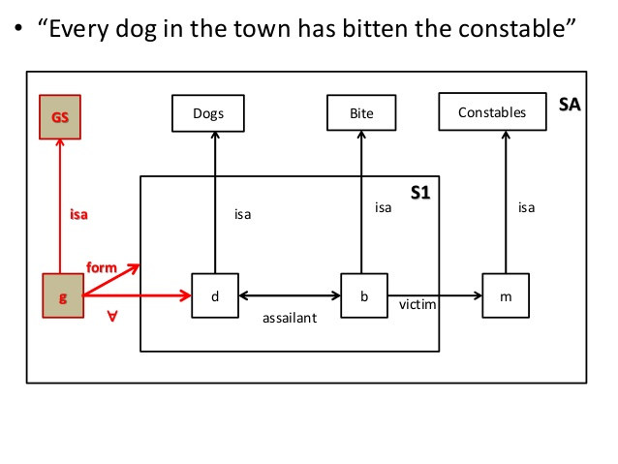

Slide 13
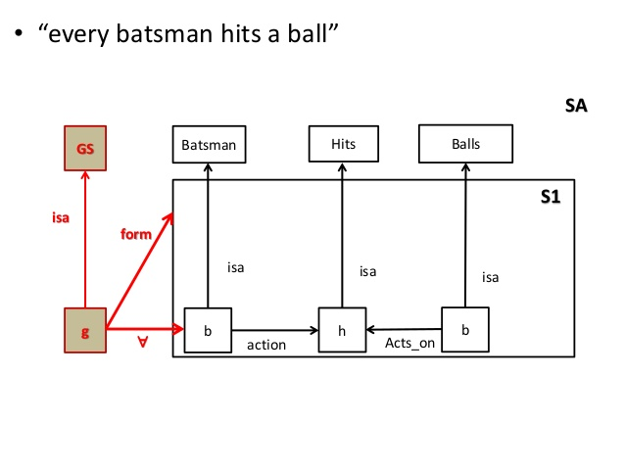

Slide 14
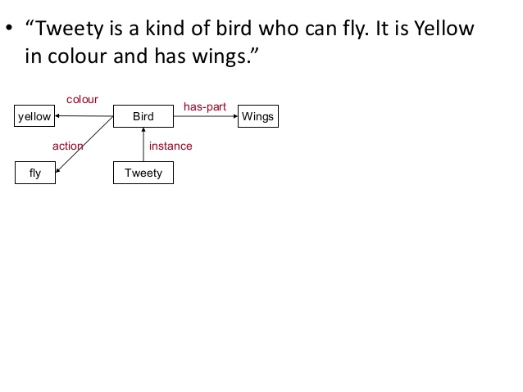

Slide 15
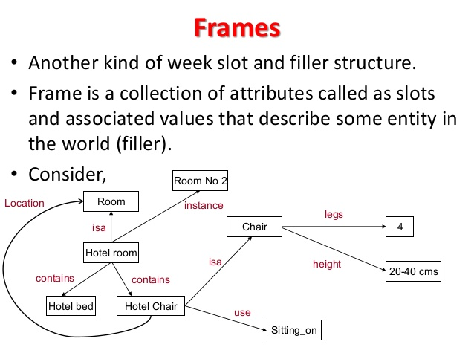

Slide 16
Frames
Frames can also be regarded as an extension to Semantic nets.
Semantic nets initially we used to represent labeled connections between objects.
As tasks become more complex the representation needs to be more structured.
The more structured the system it becomes more beneficial to use frames.
Frames are general record-like structures which consist of a collection of slots and slot values.
Slots may be of any size and type.
Slots typically have names and values or subfields called facets.
Facets may also have names and any number of values.

Slide 17
SYNTAX A general frame structure
(<frame name>
(<slot1> (<facet1><value1>…..<valuek1>)
(<facet2><value2>…..<valuek2>)
.
.
.
(<slot2> (<facet1><value1>…..<valuekm>)
.
.
. )

Slide 18
Example
Bob is a professor. His age is 42. His wife’s name is Sandy. His children’s names are Sue and Joe. His address is Street 100, Dallas City, TX State, ZIP 75000.
(bob
(PROFESSION (VALUE professor))
(AGE (VALUE 42))
(WIFE (VALUE sandy))
(CHILDREN (VALUE sue joe))
(ADDRESS (STREET (VALUE 100 elm))
(CITY (VALUE dallas))
(STATE (VALUE tx))
(ZIP (VALUE 75000))))

Slide 19
Example
Ford is a car. Its color is silver. It has 4 doors. Its gas mileage is 90 km/h. Its weight is 2600kg. Its fuel capacity is 18L.
(ford (AKO (VALUE car))
(COLOR (VALUE silver))
(MODEL (VALUE 4-door))
(GAS-MILEAGE (DEFAULT fget))
(WEIGHT (VALUE 2600))
(FUEL-CAPACITY (VALUE 18))
.
.
.

Slide 20
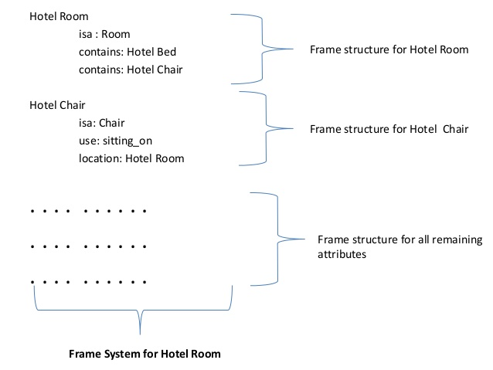

Slide 21
